Slide 1
Query Processing

Slide 2
Query Processing
Overview
Measures of Query Cost
Selection Operation
Sorting
Join Operation
Other Operations
Evaluation of Expressions

Slide 3
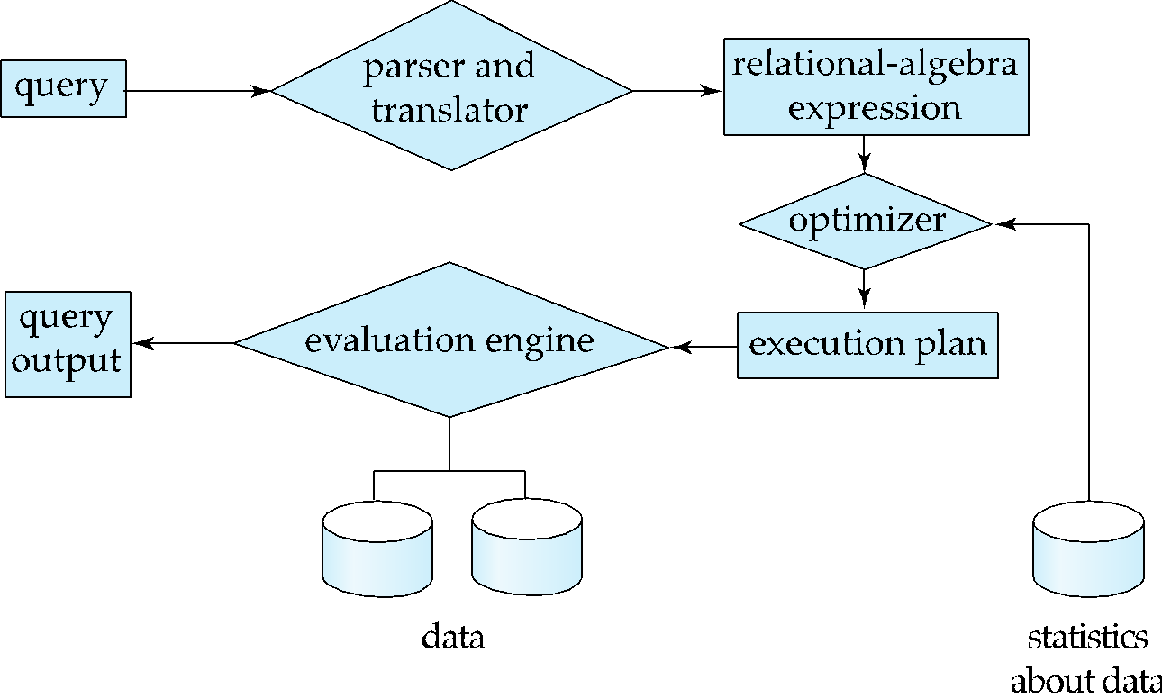
Basic Steps in Query Processing
1. Parsing and translation
2. Optimization
3. Evaluation

Slide 4
Basic Steps in Query Processing (Cont.)
Parsing and translation
translate the query into its internal form. This is then translated into relational algebra.
Parser checks syntax, verifies relations
Evaluation
The query-execution engine takes a query-evaluation plan, executes that plan, and returns the answers to the query.

Slide 5
Basic Steps in Query Processing: Optimization
EQUIVALENT OF EXPRESSION?
Given schema
instructor (id, name, dept-name, salary)
Query: Write relational algebra expression to find id and salary of all instructors whose id is greater than 50501.
SQL: SELECT id, salary FROM INSTRUCTOR WHERE id>50501
Answer 1: σ_{id>50501}(∏_{id, salary}(instructor))
equivalent to
Answer 2: ∏_{id, salary}(σ_{id>50501}(instructor))
Discussion 1: Instructor is stored physically sorted order of id. Will the query processing cost of answer 1 and answer 2 be the same? How?

Slide 6
Basic Steps in Query Processing: Optimization
Each relational algebra operation can be evaluated using one of several different algorithms
Correspondingly, a relational-algebra expression can be evaluated in many ways.
Annotated expression specifying detailed evaluation strategy is called an evaluation-plan. E.g.,:
Use an index on id to find instructors with id > 50501 (Answer 2),
Or perform complete relation scan and discard instructors with id <= 50501 (Answer 1)

Slide 7
Basic Steps: Optimization (Cont.)
Query Optimization: Amongst all equivalent evaluation plans choose the one with lowest cost.
Cost is estimated using statistical information from the database catalog
e.g.. number of tuples in each relation, size of tuples, etc.
In this chapter we study
How to measure query costs
Algorithms for evaluating relational algebra operations
How to combine algorithms for individual operations in order to evaluate a complete expression

Slide 8
Measures of Query Cost
Many factors contribute to time cost
disk access, CPU, and network communication
Cost can be measured based on
response time, i.e. total elapsed time for answering query, or
total resource consumption
We use total resource consumption as cost metric
Response time harder to estimate, and minimizing resource consumption is a good idea in a shared database
We ignore CPU costs for simplicity
Real systems do take CPU cost into account
Network costs must be considered for parallel systems
We describe how to estimate the cost of each operation
We do not include cost to writing output to disk
Which cost we will consider
for query evaluation plan?
Explain why? Why not?

Slide 9
Measures of Query Cost
Disk cost can be estimated as:
Number of seeks * average-seek-cost
Number of blocks read * average-block-read-cost
Number of blocks written * average-block-write-cost
What is number of seeks?
Answer: The number of times, the disk head directly moves from one track to another track.
What is number of block reads?
Answer: The number of blocks need to be transferred from disk to memory to process the query.
What is number of blocks written?
Answer: The number of blocks need to be written to disk from memory to process the query.

Slide 10
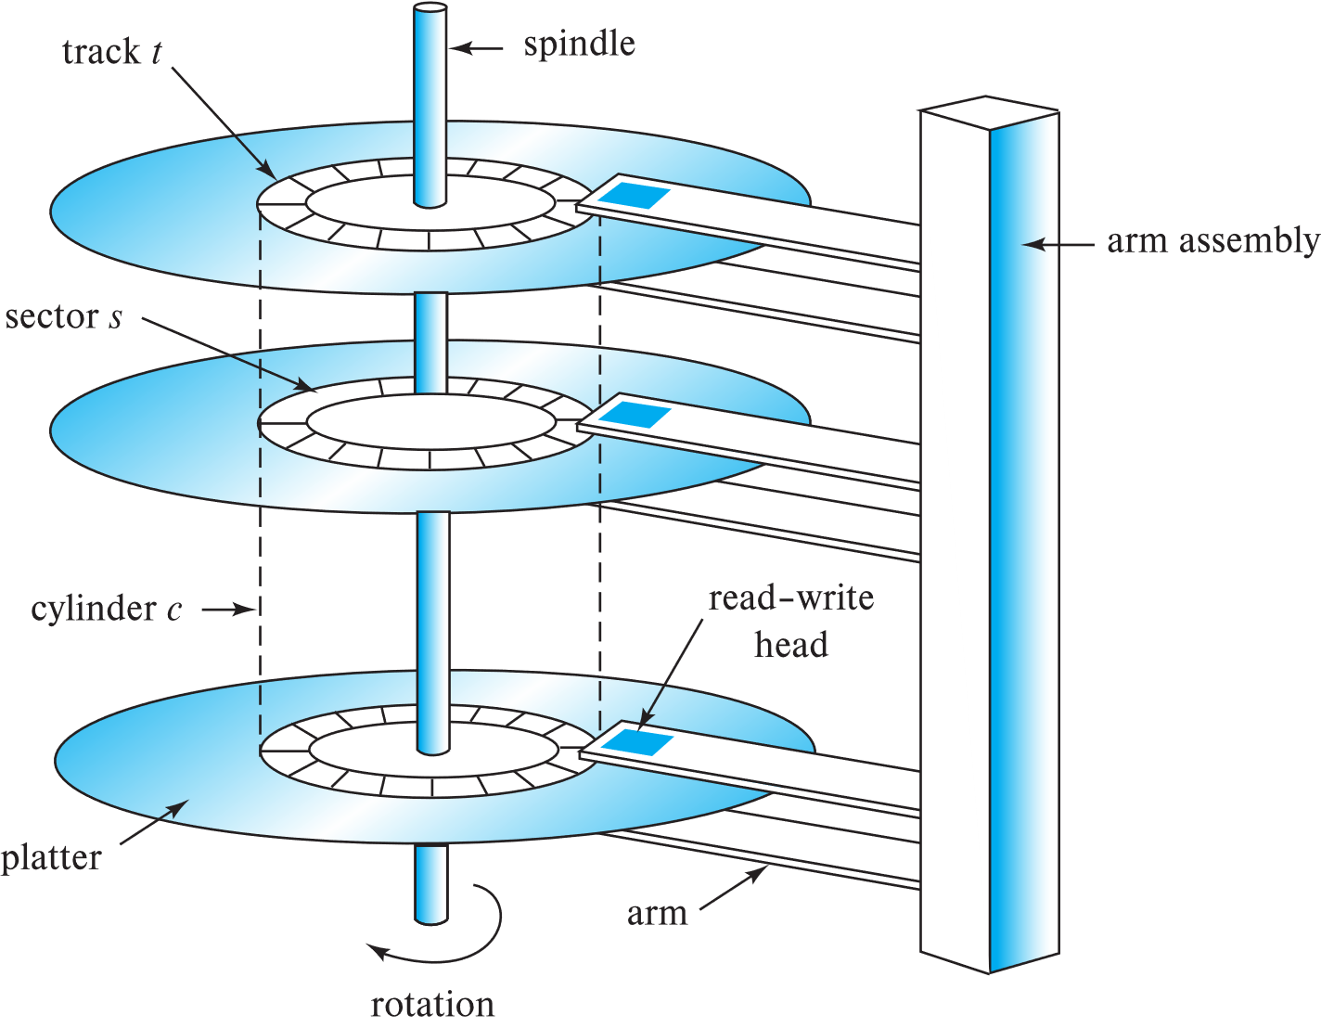

Magnetic Hard Disk Mechanism
Schematic diagram of magnetic disk drive
Photo of magnetic disk drive

Slide 11
Measures of Query Cost
For simplicity we just use the number of block transfers from disk and the number of seeks as the cost measures
t_{T} – time to transfer one block
Assuming for simplicity that write cost is same as read cost
t_{S} – time for one seek
Cost for b block transfers plus S seeks b * t_{T} + S * t_{S}
t_{S} and t_{T} depend on where data is stored; with 4 KB blocks:
High end magnetic disk: t_{S} = 4 msec and t_{T} =0.1 msec
SSD: t_{S} = 20-90 microsec and t_{T} = 2-10 microsec for 4KB

Slide 12
Selection Operation
File scan
Algorithm A1 (linear search). Scan each file block and test all records to see whether they satisfy the selection condition.
Cost estimate = b_{r} block transfers + 1 seek
b_{r} denotes number of blocks containing records from relation r
If selection is on a key attribute, can stop on finding record
cost = (b_{r} /2) block transfers + 1 seek
Linear search can be applied regardless of
Selection condition or
Ordering of records in the file, or
Availability of indices
Note: binary search generally does not make sense since data is not stored consecutively
except when there is an index available,
and binary search requires more seeks than index search

Slide 13
Selections Using Indices
Index scan – search algorithms that use an index
Selection condition must be on search-key of index.
A2 (primary index, equality on key). Retrieve a single record that satisfies the corresponding equality condition
Let h_{i} denote the height of the index tree
Cost = (h_{i} + 1) * (t_{T} + t_{S})
A5 (primary index, comparison). (Relation is sorted on A)
For σ_{A ≥ V}(r) use index to find first tuple ≥ v and scan relation sequentially from there
For σ_{A≤V} (r) just scan relation sequentially till first tuple > v; do not use index
ID | Name | Dept_name | tot_Cred
25001 | Fatema | ECE | 120
25002 | Sajid | Math | 100
25003 | Abid | Accounting | 120
25004 | Fatema | ECE | 50
25005 | Sajid | Math | 120
25006 | Shafique | Accounting | 100
25007 | Abid | ECE | 120
25008 | Fatema | Math | 50
25009 | Sajid | ECE | 120
25010 | Shafique | Math | 100

Slide 14
Selections Using Indices
Index scan – search algorithms that use an index
Selection condition must be on search-key of index.
A3 (primary index, equality on nonkey) Retrieve multiple records.
Records will be on consecutive blocks
Let b = number of blocks containing matching records
Cost = h_{i} * (t_{T} + t_{S}) + t_{S} + t_{T} * b
ID | Name | Dept_name | tot_Cred
25003 | Abid | Accounting | 120
25007 | Abid | ECE | 120
25001 | Fatema | ECE | 120
25004 | Fatema | ECE | 50
25008 | Fatema | Math | 50
25002 | Sajid | Math | 100
25005 | Sajid | Math | 120
25009 | Sajid | ECE | 120
25006 | Shafique | Accounting | 100
25010 | Shafique | Math | 100

Slide 15
Selections Using Indices
A4 (secondary index, equality on nonkey).
Retrieve a single record if the search-key is a candidate key
Cost = (h_{i} + 1) * (t_{T} + t_{S})
Retrieve multiple records if search-key is not a candidate key
each of n matching records may be on a different block
Cost = (h_{i} + n) * (t_{T} + t_{S})
Can be very expensive!
ID | Name | Dept_name | tot_Cred
25001 | Fatema | ECE | 120
25002 | Sajid | Math | 100
25003 | Abid | Accounting | 120
25004 | Fatema | ECE | 50
25005 | Sajid | Math | 120
25006 | Shafique | Accounting | 100
25007 | Abid | ECE | 120
25008 | Fatema | Math | 50
25009 | Sajid | ECE | 120
25010 | Shafique | Math | 100
Notes:
15

Slide 16
Selections Using Indices
A6 (secondary index, comparison).
For σ_{A ≥ V}(r) use index to find first index entry ≥ v and scan index sequentially from there, to find pointers to records.
For σ_{A≤V} (r) just scan leaf pages of index finding pointers to records, till first entry > v
In either case, retrieve records that are pointed to
requires an I/O for each record
Linear file scan may be cheaper
ID | Name | Dept_name | tot_Cred
25001 | Fatema | ECE | 120
25002 | Sajid | Math | 100
25003 | Abid | Accounting | 120
25004 | Fatema | ECE | 50
25005 | Sajid | Math | 120
25006 | Shafique | Accounting | 100
25007 | Abid | ECE | 120
25008 | Fatema | Math | 50
25009 | Sajid | ECE | 120
25010 | Shafique | Math | 100
Notes:
16

Slide 17
Implementation of Complex Selections
Conjunction: σ_{θ1}∧ _{θ2}∧. . . _{θn}(r)
A7 (conjunctive selection using one index).
Select a combination of θ_{i} and algorithms A1 through A7 that results in the least cost for σ_{θi} (r).
Test other conditions on tuple after fetching it into memory buffer.

Slide 18
Algorithms for Complex Selections
Disjunction:σ_{θ1}∨ _{θ2} ∨. . . _{θn} (r).
A10 (disjunctive selection by union of identifiers).
Applicable if all conditions have available indices.
Otherwise use linear scan.
Use corresponding index for each condition, and take union of all the obtained sets of record pointers.
Then fetch records from file

Slide 19
Sorting
We may build an index on the relation, and then use the index to read the relation in sorted order. May lead to one disk block access for each tuple.
Discussion: The case when it May lead to one disk block access for each tuple.
For relations that fit in memory, techniques like quicksort can be used.
For relations that don’t fit in memory, quicksort is not applicable. Why? external sort-merge is a good choice in this case.

Slide 20
Example: External Sorting Using Sort-Merge

Slide 21

External Sort-Merge (Run Creation)
Memory
Run Creation
Let M denote memory size (in pages).
Here M = 3
1. Create sorted runs. Let i be 0 initially. Repeatedly do the following till the end of the relation: (a) Read M blocks of relation into memory (b) Sort the in-memory blocks (c) Write sorted data to run R_{i}; increment i.
Let the final value of i be N (Here N = ?)
R1
R2
R3
Here N = 4
2. Merge the runs (next slide)…..
R4

Slide 22
External Sort-Merge (Sort-Merge)
a | 19
b | 14
Input Buffer
Output
Buffer
Merge the runs (2-way merge). Here N > M. M=3, N=4
Use 2 blocks of memory to buffer input runs, and 1 block to buffer output. Read the first block of each run into its buffer page
repeat
Select the first record (in sort order) among all buffer pages
Write the record to the output buffer. If the output buffer is full write it to disk.
Delete the record from its input buffer page. If the buffer page becomes empty then read the next block (if any) of the run into the buffer.
until all input buffer pages are empty:
a | 19
Merge pass1
R1
R2
R3
R4

Slide 23
External Sort-Merge (Sort Merge)
b | 14
d | 31
Memory
Merge the runs (2-way merge). Here N > M. M=3, N=2
Use 2 blocks of memory to buffer input runs, and 1 block to buffer output. Read the first block of each run into its buffer page
repeat
Select the first record (in sort order) among all buffer pages
Write the record to the output buffer. If the output buffer is full write it to disk.
Delete the record from its input buffer page. If the buffer page becomes empty then read the next block (if any) of the run into the buffer.
until all input buffer pages are empty:
b | 14
Merge pass1
R1
R2
R3
R4

Slide 24
External Sort-Merge (Algorithm Analysis)
b | 14
d | 31
Memory
Merge pass2
If N ≥ M, several merge passes are required.
Here, it is 2
In each pass, contiguous groups of M - 1 runs are merged.
A pass reduces the number of runs by a factor of M -1, and creates runs longer by the same factor.
E.g. If M=11, and there are 90 runs, one pass reduces the number of runs to 9, each 10 times the size of the initial runs
Repeated passes are performed till all runs have been merged into one.
b | 14
Merge pass1
R1
R2
R3
R4

Slide 25
External Sort-Merge (Algorithm Analysis)
b | 14
d | 31
Memory
Merge pass2
b | 14
Merge pass1
Problem: Find the number of runs, number of passes, number of blocks transfer and number of seeks for a relation with br blocks. Memory size is M, number of runs is N and N > M.
Cost analysis (Total number of passes)
Total number of blocks of the relation is b_{r}
Size of the memory is M
Total number of runs = ⎡(b_{r}/M)⎤
R1
R2
R3
R4

Slide 26
External Sort-Merge (Algorithm Analysis)
b | 14
d | 31
Memory
Merge pass2
b | 14
Merge pass1
Cost analysis (Total number of passes)
Total number of blocks of the relation is b_{r}
Size of the memory is M
Total number of runs = ⎡(b_{r}/M)⎤
After merge pass 1, number of runs = ⎡ ⎡(b_{r}/M)⎤ /(M-1) ⎤
After merge pass 2, number of runs
= ⎡ ⎡(b_{r}/M)⎤ /(M-1) (M-1) ⎤
= ⎡ ⎡(b_{r}/M)⎤ /(M-1) ²⎤
Total number of pass = ⎡log _{(M–1)}(b_{r}/M)⎤.
R1
R2
R3
R4

Slide 27
External Sort-Merge (Algorithm Analysis)
b | 14
d | 31
Memory
Merge pass2
b | 14
Cost analysis (Total number of block transfer)
Block transfers for initial run creation as well as in each pass is 2b_{r}
for final pass, we don’t count write cost
since the output of an operation may be sent to the parent operation
Block transfer for run creation
= b_{r} for read+ b_{r} for write = 2 b_{r}
Block transfers for merging = 2 b_{r} * ⎡log _{(M–1)}(b_{r}/M)⎤
BT for run and merge (B_RM) = 2 b_{r} + 2 b_{r} * ⎡log _{(M–1)}(b_{r}/M)⎤
Final merge, no write.
So Net block transfer = B_RM - b_{r}
= 2 b_{r} + 2 b_{r} * ⎡log _{(M–1)}(b_{r}/M)⎤ - b_{r}
= b_{r} * (2 * ⎡log _{(M–1)}(b_{r}/M)⎤ +1)
Merge pass1
R1
R2
R3
R4

Slide 28
External Sort-Merge (Algorithm Analysis)
b | 14
d | 31
Memory
Merge pass2
b | 14
Cost analysis (Total number of seek)
During run generation: one seek to read each run and one seek to write each run
2 ⎡b_{r} / M⎤
During the merge phase
Need 2 b_{r} seeks for each merge pass except the final one which does not require a write
Total number of seeks:
= seek for run creation + seek for merge
= 2 ⎡b_{r} / M⎤ + 2b_{r} ⎡log_{M–1}(b_{r} / M)⎤ - b_{r}
= 2 ⎡b_{r} / M⎤ + b_{r} ( 2 ⎡log_{M–1}(b_{r} / M)⎤ - 1)
Merge pass1
R1
R2
R3
R4

Slide 29
Join Operation
Several different algorithms to implement joins
Nested-loop join
Block nested-loop join
Choice based on cost estimate
Examples use the following information
Number of records of student: 20,000 takes: 40,000
Number of blocks of student: 2000 takes: 400

Slide 30
Nested-Loop Join
Cost Analysis (Block transfer)
Case 1: (worst case),
n_{r} = total number of tuples in r
b_{r} = number of blocks in r
b_{s}= number of blocks in s
if there is enough memory only to hold one block of each relation,
the estimated block transfers is n_{r} ∗ b_{s} + b_{r}
Number of seek = n_{r} + b_{r}
To compute the theta join
r ⨝ _{θ} s
for each tuple t_{r} in r do begin
for each tuple t_{s} in s do begin test pair (t_{r},t_{s}) to see if they satisfy the join condition θ if they do,
add t_{r} • t_{s} to the result. end end
r is the outer relation and s the inner relation of the join.
M1
M2
Iteration 1
r
s
Expensive since it examines every pair of tuples in the two relations.
B1(r)
B2(r)
B3(r)
……..
Br(r)
B1(s)
B2(s)
……..
Bs(s)

Slide 31
Nested-Loop Join
Cost Analysis (Block transfer)
Case 1: (worst case),
n_{r} = total number of tuples in r
b_{r} = number of blocks in r
b_{s}= number of blocks in s
if there is enough memory only to hold one block of each relation,
the estimated block transfers is n_{r} ∗ b_{s} + b_{r}
Number of seek = n_{r} + b_{r}
To compute the theta join
r ⨝ _{θ} s
for each tuple t_{r} in r do begin
for each tuple t_{s} in s do begin test pair (t_{r},t_{s}) to see if they satisfy the join condition θ if they do,
add t_{r} • t_{s} to the result. end end
r is the outer relation and s the inner relation of the join.
M1
M2
Iteration 1
Expensive since it examines every pair of tuples in the two relations.
B1
B2
B3
……..
Br
B1
B2
……..
Bs

Slide 32
Nested-Loop Join
Cost Analysis (Block transfer)
Case 1: (worst case),
n_{r} = total number of tuples in r
b_{r} = number of blocks in r
b_{s}= number of blocks in s
if there is enough memory only to hold one block of each relation,
the estimated block transfers is n_{r} ∗ b_{s} + b_{r}
Number of seek = n_{r} + b_{r}
To compute the theta join
r ⨝ _{θ} s
for each tuple t_{r} in r do begin
for each tuple t_{s} in s do begin test pair (t_{r},t_{s}) to see if they satisfy the join condition θ if they do,
add t_{r} • t_{s} to the result. end end
r is the outer relation and s the inner relation of the join.
M1
M2
Iteration 1
Expensive since it examines every pair of tuples in the two relations.
B1
B2
B3
……..
Br
B1
B2
……..
Bs

Slide 33
Nested-Loop Join
for each tuple t_{r} in r do begin
for each tuple t_{s} in s do begin test pair (t_{r},t_{s}) to see if they satisfy the join condition θ if they do,
add t_{r} • t_{s} to the result. end end
M1
M2
M3
……
Mn
Cost Analysis (Block transfer)
Case 2 (Best Case): the smaller relation fits entirely in memory, use that as the inner relation
B_{r} = number of blocks in r
B_{s}= number of blocks in s
the estimated block transfers is b_{s} + b_{r}
Number of seek = 2
B1
B2
B3
……..
Br
B1
B2
……..
Bs

Slide 34
Nested-Loop Join
for each tuple t_{r} in student do begin
for each tuple t_{s} in takes do begin test pair (t_{r},t_{s}) to see if they satisfy the join condition θ if they do,
add t_{r} • t_{s} to the result. end end
Cost Analysis (Block transfer)
Case 1: (worst case),
B_{r} = number of blocks in r
B_{s}= number of blocks in s
if there is enough memory only to hold one block of each relation,
the estimated block transfers is n_{r} ∗ b_{s} + b_{r}
Number of seek = n_{r} + b_{r}
Relation | No. of records | No. of blocks
student | 20000 | 2000
takes | 40000 | 400
M1
M2
Iteration 1
B1
B2
B3
……..
B₂₀₀₀
B1
B2
……..
B₄₀₀
Problem : The relation schema are
Student (id, name, cgpa, tot-cred, street, city, NID)
Takes (id, course-id, semester, year)
Write the SQL and algebra to find id, name, course id and semester
Find the worst case number of block transfer and number of seek

Slide 35
Nested-Loop Join
for each tuple t_{r} in student do begin
for each tuple t_{s} in takes do begin test pair (t_{r},t_{s}) to see if they satisfy the join condition θ if they do,
add t_{r} • t_{s} to the result. end end
Solution
b_{r} = 2000
b_{s}= 400
memory only holds one block of each relation,
the estimated block transfers is n_{r} ∗ b_{s} + b_{r} = 20000 * 400 + 2000
Number of seek = n_{r} + b_{r} = 20000+2000
Relation | No. of records | No. of blocks
student | 20000 | 2000
takes | 40000 | 400
M1
M2
Iteration 1
B1
B2
B3
……..
B₂₀₀₀
B1
B2
……..
B₄₀₀
Problem : The relation schema are
Student (id, name, cgpa, tot-cred, street, city, NID)
Takes (id, course-id, semester, year)
Write the SQL and algebra to find id, name, course id and semester
Find the worst case number of block transfer and number of seek

Slide 36
Nested-Loop Join
for each tuple t_{r} in student do begin
for each tuple t_{s} in takes do begin test pair (t_{r},t_{s}) to see if they satisfy the join condition θ if they do,
add t_{r} • t_{s} to the result. end end
Solution
b_{r} = 2000
b_{s}= 400
memory only holds one block of each relation,
the estimated block transfers is b_{s} + b_{r} = 400 + 2000
Number of seek = 2
Relation | No. of records | No. of blocks
student | 20000 | 2000
takes | 40000 | 400
M1
M2
M3
……
Mn
Problem:
Find the best case number of block transfer and number of seek
B1
B2
B3
……..
B₂₀₀₀
B1
B2
……
B₄₀₀
Discussion: Write a discussion on nested loop join considering cost.

Slide 37
Block Nested-Loop Join
Variant of nested-loop join in which every block of inner relation is paired with every block of outer relation.
for each block B_{r} of r do begin for each block B_{s} of s do begin for each tuple t_{r} in B_{r} do begin for each tuple t_{s} in B_{s} do begin Check if (t_{r},t_{s}) satisfy the join condition if they do, add t_{r} • t_{s} to the result. end end end end
M1
M2
Iteration 1
B1
B2
B3
……..
B₂₀₀₀
B1
B2
……..
B₄₀₀

Slide 38
Block Nested-Loop Join
Variant of nested-loop join in which every block of inner relation is paired with every block of outer relation.
for each block B_{r} of r do begin for each block B_{s} of s do begin for each tuple t_{r} in B_{r} do begin for each tuple t_{s} in B_{s} do begin Check if (t_{r},t_{s}) satisfy the join condition if they do, add t_{r} • t_{s} to the result. end end end end
M1
M2
Iteration 1
B1
B2
B3
……..
B₂₀₀₀
B1
B2
……..
B₄₀₀

Slide 39
Block Nested-Loop Join
Variant of nested-loop join in which every block of inner relation is paired with every block of outer relation.
for each block B_{r} of r do begin for each block B_{s} of s do begin for each tuple t_{r} in B_{r} do begin for each tuple t_{s} in B_{s} do begin Check if (t_{r},t_{s}) satisfy the join condition if they do, add t_{r} • t_{s} to the result. end end end end
M1
M2
Iteration 1
B1
B2
B3
……..
B₂₀₀₀
B1
B2
……..
B₄₀₀

Slide 40
Block Nested-Loop Join
Variant of nested-loop join in which every block of inner relation is paired with every block of outer relation.
for each block B_{r} of r do begin for each block B_{s} of s do begin for each tuple t_{r} in B_{r} do begin for each tuple t_{s} in B_{s} do begin Check if (t_{r},t_{s}) satisfy the join condition if they do, add t_{r} • t_{s} to the result. end end end end
M1
M2
Iteration 2
B1
B2
B3
……..
B₂₀₀₀
B1
B2
……..
B₄₀₀

Slide 41
Block Nested-Loop Join
Cost Analysis (Block transfer)
Case 2 (Worst Case):
the estimated block transfers is b_{r} * b_{s} + b_{r}
Number of seek = b_{s} + b_{r}
Variant of nested-loop join in which every block of inner relation is paired with every block of outer relation.
for each block B_{r} of r do begin for each block B_{s} of s do begin for each tuple t_{r} in B_{r} do begin for each tuple t_{s} in B_{s} do begin Check if (t_{r},t_{s}) satisfy the join condition if they do, add t_{r} • t_{s} to the result. end end end end
M1
M2
Iteration 2
B1
B2
B3
……..
B₂₀₀₀
B1
B2
……..
B₄₀₀

Slide 42
Block Nested-Loop Join
Cost Analysis (Block transfer)
Case 2 (Best Case): the smaller relation fits entirely in memory, use that as the inner relation
the estimated block transfers is b_{s} + b_{r}
Number of seek = 2
Variant of nested-loop join in which every block of inner relation is paired with every block of outer relation.
for each block B_{r} of r do begin for each block B_{s} of s do begin for each tuple t_{r} in B_{r} do begin for each tuple t_{s} in B_{s} do begin Check if (t_{r},t_{s}) satisfy the join condition if they do, add t_{r} • t_{s} to the result. end end end end
M1
M2
Iteration 2
B1
B2
B3
……..
B₂₀₀₀
B1
B2
……..
B₄₀₀

Slide 43
Evaluation of Expressions
So far: we have seen algorithms for individual operations
Alternatives for evaluating an entire expression tree
Materialization: generate results of an expression whose inputs are relations or are already computed, materialize (store) it on disk. Repeat.
Pipelining: pass on tuples to parent operations even as an operation is being executed
We study above alternatives in more detail
π_{name}((σ_{building = ‘Watson’}(department)) ⨝ instructor)

Slide 44
Materialization
Materialized evaluation: evaluate one operation at a time, starting at the lowest-level. Use intermediate results materialized into temporary relations to evaluate next-level operations.
The department and tinstructor schemas are given below:
instructor (id, name, dept-name, salary)
Department (dept-name, building, budget)
Write relational algebra to find the names of all instructors of all departments in ‘Watson’ building.
Show the query expression tree (operation tree) for the query.
Relational algebra
π_{name}((σ_{building = ‘Watson’}(department)) ⨝ instructor)
Query expression tree

Slide 45
Materialization
Materialized evaluation: evaluate one operation at a time, starting at the lowest-level. Use intermediate results materialized into temporary relations to evaluate next-level operations.
Problem 12: The student and takes schemas are given below:
student (id, name, CGPA, year-admit)
Takes (id, course-id, semester, year)
Write relational algebra to find the names and CGPA of all students of spring 2019.
Show the query expression tree (operation tree) for the query.
Relational algebra
π_{name}((σ_{building = ‘Watson’}(department)) ⨝ instructor)
Query expression tree

Slide 46
Materialization (Cont.)
Materialized evaluation is always applicable
Cost of writing results to disk and reading them back can be quite high
Our cost formulas for operations ignore cost of writing results to disk, so
Overall cost = Sum of costs of individual operations + cost of writing intermediate results to disk
Write Cost
Write Cost

Slide 47
Materialization (Cont.)
Problem 13: The cost of (σ_{building = ‘Watson’}(department) is 1 seek and 20 block transfer.
The cost of ((σ_{building = ‘Watson’} (department)) ⨝ instructor) is 10 seek and 100 block transfer.
The cost of π_{name} (…….) is 1 seek and 50 block transfer.
Write cost for (σ_{building = ‘Watson’}(department) is 1 seek and 10 block transfer
Write cost for ⨝ is 1 seek and 50 block transfer
Find overall cost of the query.
Write Cost
Write Cost

Slide 48
Materialization (Cont.)
Problem 13: The cost of (σ_{building = ‘Watson’}(department) is 1 seek and 20 block transfer.
The cost of ((σ_{building = ‘Watson’} (department)) ⨝ instructor) is 10 seek and 100 block transfer.
The cost of π_{name} (…….) is 1 seek and 50 block transfer.
Write cost for (σ_{building = ‘Watson’}(department) is 1 seek and 10 block transfer
Write cost for ⨝ is 1 seek and 50 block transfer
Find overall cost of the query.
Write Cost
Write Cost
Overall cost = Sum of costs of individual operations + cost of writing intermediate results to disk
= ((1+10+1) seek + (20+100+50) blocks) + ((1+1) seek + (10+50) blocks)
= (12Seek+170Blocks) + (2 seek + 60blocks)

Slide 49
Materialization (Cont.)
Materialized evaluation is always applicable
Cost of writing results to disk and reading them back can be quite high
Our cost formulas for operations ignore cost of writing results to disk, so
Overall cost = Sum of costs of individual operations + cost of writing intermediate results to disk
Double buffering: use two output buffers for each operation, when one is full write it to disk while the other is getting filled
Allows overlap of disk writes with computation and reduces execution time
Write (X)
Buffer 1
Buffer 2
Double Buffering
DB

Slide 50
Materialization (Cont.)
Materialized evaluation is always applicable
Cost of writing results to disk and reading them back can be quite high
Our cost formulas for operations ignore cost of writing results to disk, so
Overall cost = Sum of costs of individual operations + cost of writing intermediate results to disk
Double buffering: use two output buffers for each operation, when one is full write it to disk while the other is getting filled
Allows overlap of disk writes with computation and reduces execution time
Write (Y)
Buffer 1
Buffer 2
If Buffer 1 full
DB

Slide 51
Pipelining
Pipelined evaluation: evaluate several operations simultaneously, passing the results of one operation on to the next.
E.g., in previous expression tree, don’t store result of
instead, pass tuples directly to the join.. Similarly, don’t store result of join, pass tuples directly to projection.
Much cheaper than materialization: no need to store a temporary relation to disk.
×
Write Cost
×
Write Cost
π_{name}((σ_{building = ‘Watson’}(department)) ⨝ instructor)
Discussion: Explain how the above query is executed using pipelining and compare the cost with materialization

Slide 52
Pipelining
Pipelining may not always be possible – e.g., sort, hash-join.
For pipelining to be effective, use evaluation algorithms that generate output tuples even as tuples are received for inputs to the operation.
can be executed in two ways: demand driven and producer driven
Discussion: Explain why pipelining may not be possible in case of database sorting.
How much it is possible?

Slide 53
Example: External Sorting Using Sort-Merge

Slide 54
Pipelining (Cont.)
Output-1
In demand driven or lazy evaluation
system repeatedly requests next tuple from top level operation
Each operation requests next tuple from children operations as required, in order to output its next tuple
In between calls, operation has to maintain “state” so it knows what to return next
Alternative name: pull model of pipelining
Tuple 1
Tuple 1
Tuple 1

Slide 55
Pipelining (Cont.)
Output-1
In producer-driven or eager pipelining
Operators produce tuples eagerly and pass them up to their parents
Buffer maintained between operators, child puts tuples in buffer, parent removes tuples from buffer
if buffer is full, child waits till there is space in the buffer, and then generates more tuples
System schedules operations that have space in output buffer and can process more input tuples
Alternative name: push model of pipelining
Tuple 1
Tuple 1
Tuple 1
Discussion: Give a comparison between pull and push model of pipelining

